Slide 1
Locus
Generative AI
VisionOs

Slide 2
Project Overview

Slide 3
Project Overview
Problem
Solution
App Info
Learning a new language can be challenging, particularly when you're relying solely on textbooks for reading and writing practice. Without immersive experiences or interactive support, it can be tough to make meaningful progress.
Immersive learning is an excellent way to enhance and reinforce the language skills you’ve already acquired, offering a deeper, more practical understanding of how the language is used in real-world contexts.
Locus is a generative AI-powered app that helps users learn languages by connecting them with the world around them, turning everyday objects into interactive learning opportunities.

Slide 4
Research

Slide 5
Research
Potential Contacts
Survey
Interview
Interview with Eunkyoung Cha
Similar project to ours
Suggested research methods
Franklin College Language Professors
UGA Students
Survey given to students
Asked about methods and problems with learning a new language
Found that most desire a way to simulate conversations and incentives to keep progressing
Notes:
Immerse

Slide 6
Locus UX Map

Slide 7
Target Audience
The ideal audience for this app includes frequent travelers, digital nomads, and language enthusiasts who seek a more immersive and interactive way to learn and communicate. Whether for global explorers looking to navigate foreign cities effortlessly or dedicated learners striving for fluency through spatial computing, this app redefines the way users interact with language blurring the line between learning and living it.

Slide 8
The Traveler
Adventurous and always on the move, The Traveler is a passionate globetrotter who thrives on cultural immersion. Whether wandering through bustling markets in Tokyo or exploring hidden cafés in Paris, they believe that language is the key to unlocking authentic experiences.
With a deep appreciation for meaningful connections, The Traveler uses Locus for VR translations to bridge communication gaps and engage with locals in real time. By blending technology with travel, they’re not just sightseeing, they’re truly experiencing the world, one conversation at a time.

Slide 9
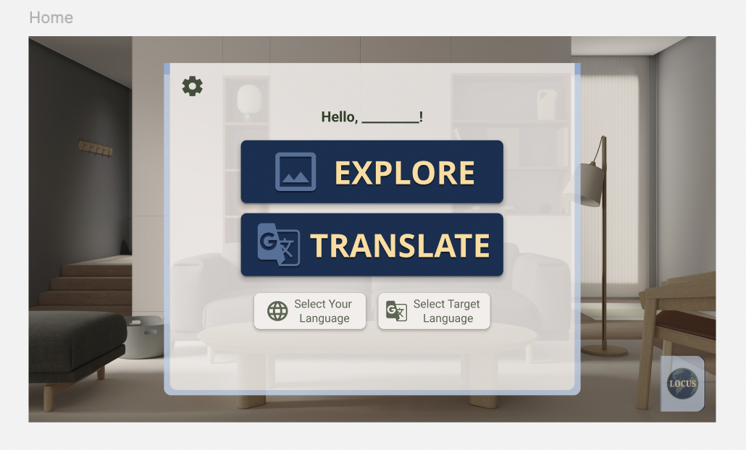
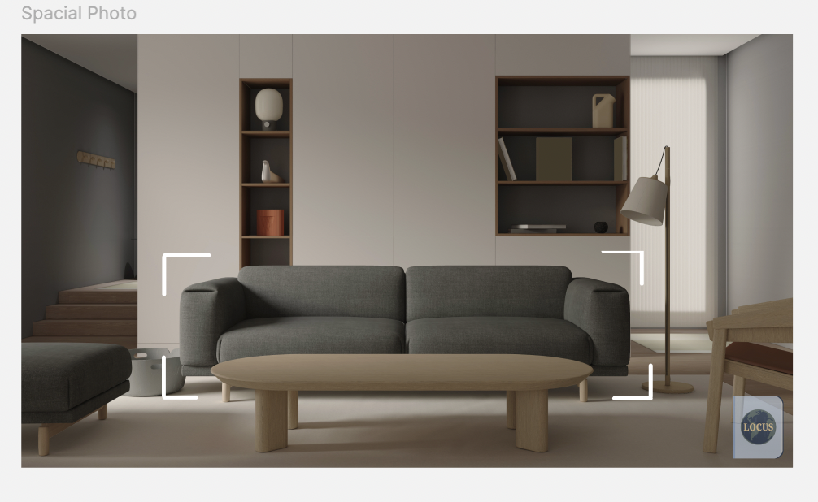
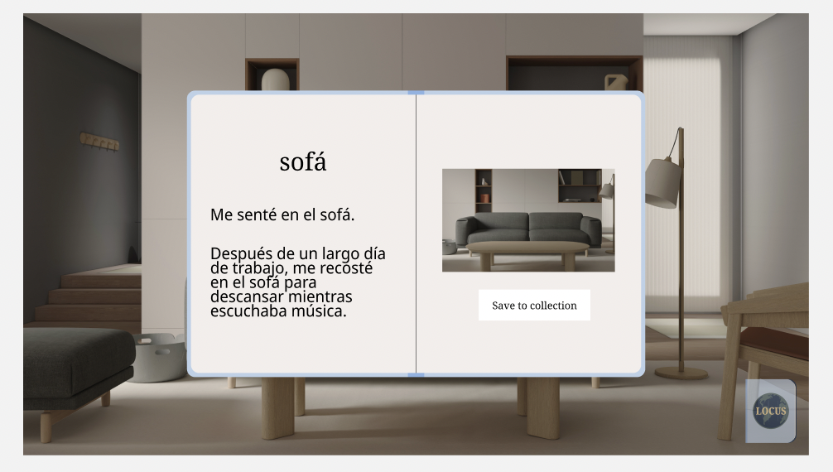
Wireframe

Slide 10
The Learner
For The Learner, language learning isn’t just about memorizing words, it’s about full immersion. With the Apple Vision Pro, they move past traditional methods into a world where language seamlessly integrates with their surroundings. As they navigate their home, object recognition and real-time translations turn everyday items into learning opportunities, transforming familiar spaces into interactive classrooms.
This next-level immersion makes learning intuitive, engaging, and natural, helping The Learner to build confidence and fluency faster than ever. With cutting-edge spatial computing, they’re not just learning a language, they’re living it.

Slide 11
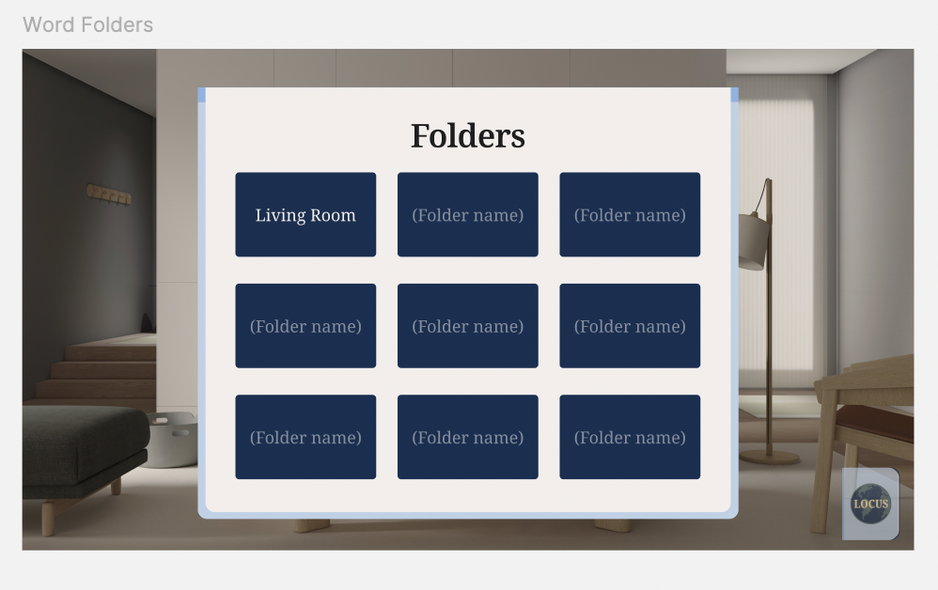
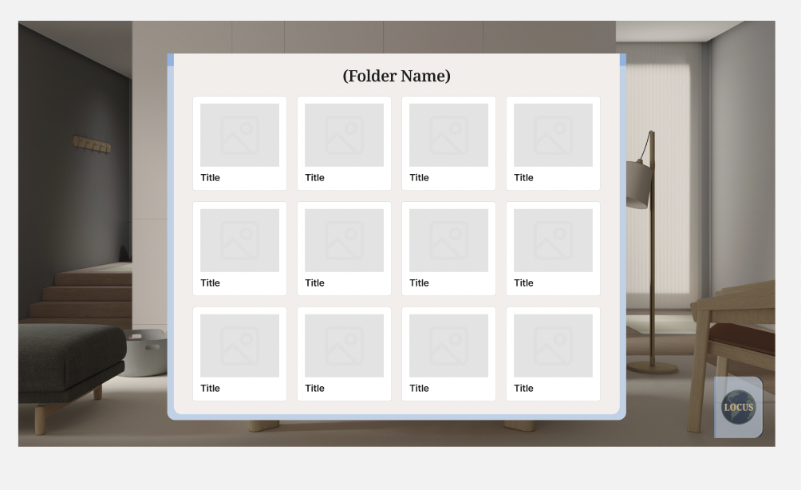
Wireframe

Slide 12
Alpha → Beta

Slide 13
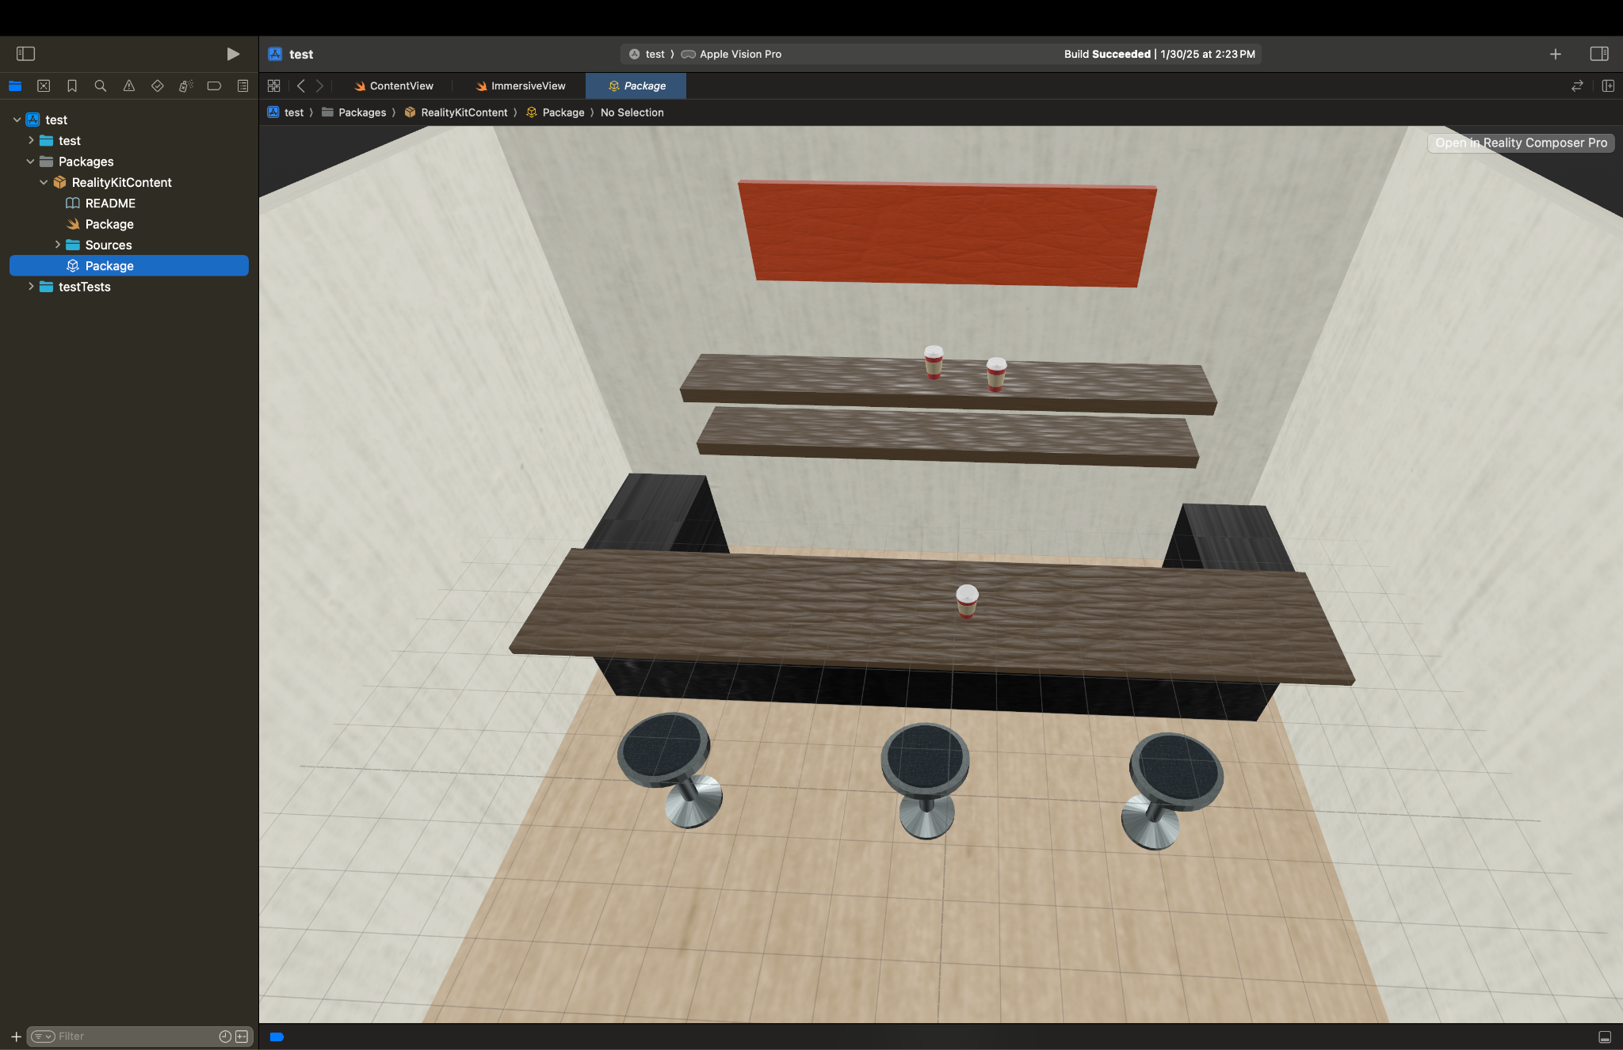
Alpha
Created 3D immersive space of Cafe using Blender and Reality Composer Pro

Slide 14
Beta!

Slide 15
Thank you

